Slide 1
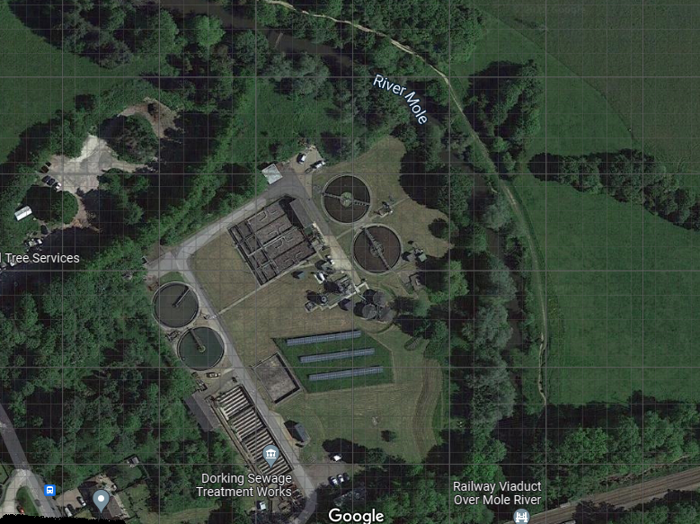

Sewage Treatment.
Pixham Lane Works

Slide 2
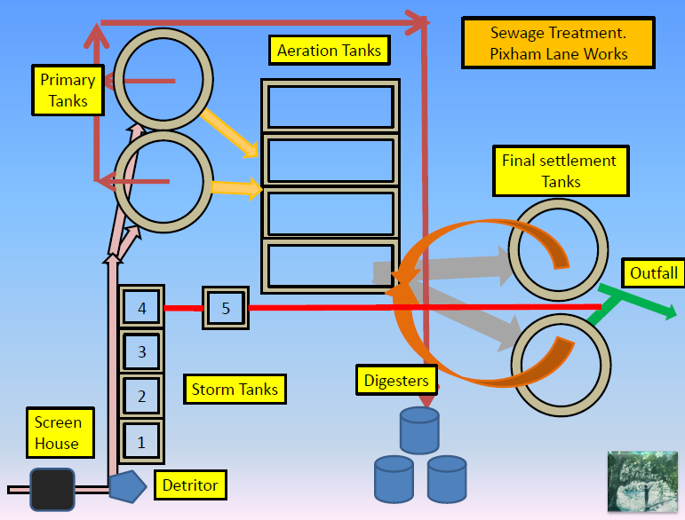
Sewage Treatment.
Pixham Lane Works

Slide 3
Sewage Treatment.
Pixham Lane Works
Aeration Tanks
Primary
Tanks
Final settlement
Tanks
Outfall
4
5
3
Storm Tanks
Digesters
2
Screen
House
1
Detritor

Slide 4
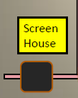
Screening

Slide 5
Screening
When wastewater enters the treatment works, it will pass through a bar screen which removes the larger solids that are put through a maserator, which reduces the size of the larger particles.

Slide 6
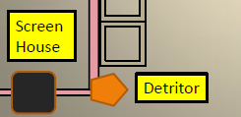
Detritor

Slide 7
Detritor
Detritor’s are a set of equipment that collectively remove fine grits from the influent stream. The equipment is an integral part of most Sewage Treatment Plants (STP), irrespective of the secondary treatment process.
The detritor is placed after a fine screen. In this stage, the heavy suspended solids such as silt, gravel, and other such items are forced to settle in the basin by dropping the velocity below the critical flow velocity.

Slide 8
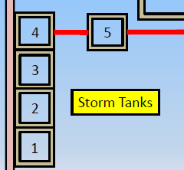
Storm tanks

Slide 9
Storm tanks
Five tanks are in place and are designed to take the excess when the flow into the works backs up from the primary tank feed channels. The back up overflows into the tanks.
The tanks can emptied back into the system when the flow subsides at a later time.
An overflow from tank five will go into the River Mole mixed with final settlement tank flow before the outfall

Slide 10
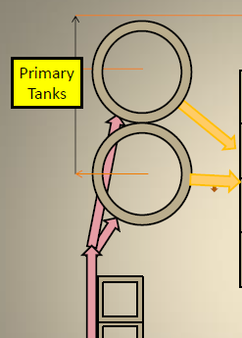
Primary settlement tanks

Slide 11
Primary settlement tanks
Wastewater still contains organic solid matter – otherwise known as human waste. To separate the waste from the water it is channelled into two settlement tanks, where solids sink to the bottom. The settled solids becomes ‘sludge’. Large arms or scrapers help to push the sludge towards the centre, where it is then pumped away for further treatment.
The cleaner water passes over a wall near the top of the tank ready for the next stage of the treatment process.

Slide 12
Primary settlement tanks
The Primary Settlement or sedimentation tanks are designed to reduce the velocity of the wastewater flow, allowing heavier organic solids (called raw sludge) to settle.
Typically, 90 – 95% of the settleable solids will settle out during primary treatment.

Slide 13
Drawing off sludge
The settled solids is described as ‘sludge’. Large arms or scrapers help to push the sludge towards the centre, where it’s then pumped away for further treatment.

Slide 14
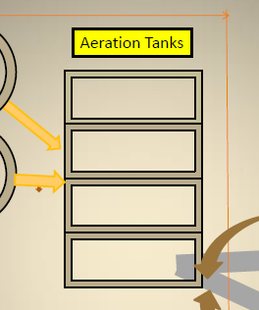
Activated sludge aeration tanks

Slide 15
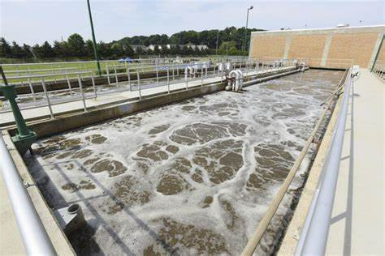
Activated sludge

Slide 16
What is activated sludge process?
The Activated Sludge Process (ASP) is a sewage treatment process in which air or oxygen is blown into raw, unsettled sewage to smash the solids and develop a biological 'soup' which digests the organic content and pollutants in the sewage.

Slide 17
The activated sludge process
Although the visible bits of sludge have been removed, the process needs to take out some of the smaller and sometimes invisible organisms as well.
At this sewage treatment works, the wastewater is put into rectangular tanks called ‘aeration lanes’, which pump air into the water. This encourages the useful bacteria to break down and eat the harmful bacteria. The more the useful bacteria eat, the more they grow and multiply, until all the nasty bugs have gone.

Slide 18
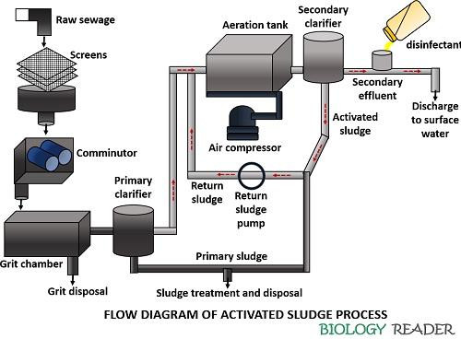

The activated sludge process

Slide 19
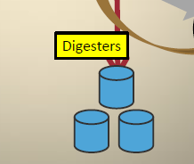
Digesters

Slide 20
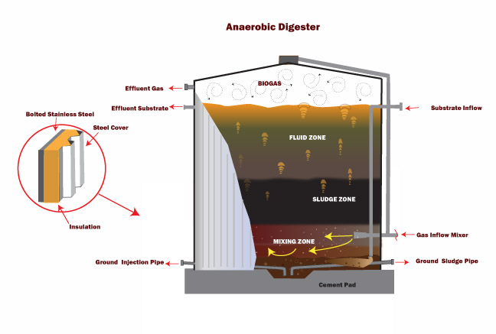
Digesters

Slide 21
Digesters
The sludge collected at the start of the process is treated so that it can put it to good use. It will be recycled, most of it to agricultural land for farmers to use as fertiliser, but it can also use it to generate energy. This in several different ways:
The works will treat the sludge using a process called ‘anaerobic digestion’. This heats the sludge up to high temperatures, encouraging the bacteria inside to break down the waste. This creates biogas that can be burned to create heat and in turn can create electricity.

Slide 22
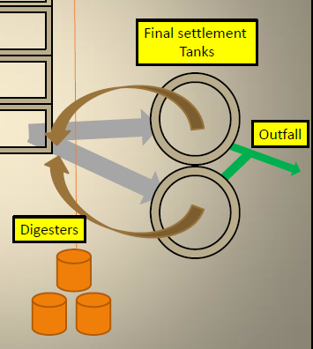
Final settlement tanks

Slide 23
Final settlement tanks
The treated wastewater passes through a final settlement tank, where the useful bacteria sink to the bottom. This forms more sludge, which is recycled back to the secondary treatment stage.
The clean water then flows from the tanks to a channel and then to the outfall into the River Mole.

Slide 24
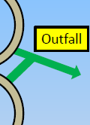
Outfall

Slide 25
Outfall
Once the wastewater is clean, it can be returned safely to local rivers and streams. Putting clean water back into the river is very important, as it helps to keep water flowing and wildlife thriving.
The Environment Agency strictly regulates the quality of the cleaned wastewater, and tests the treated water to make sure that it meets their high-quality standards.

Slide 26
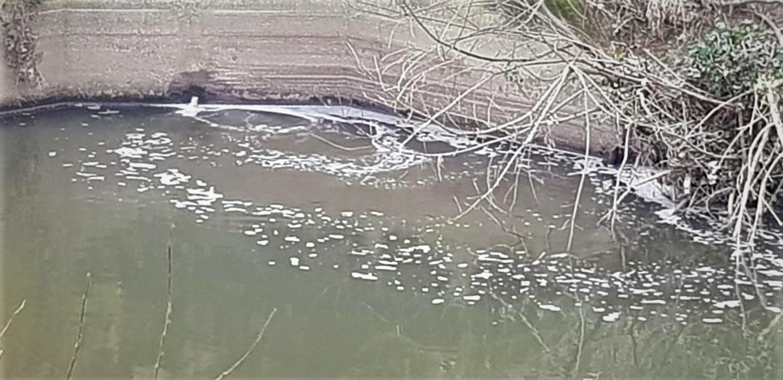
Outfall

Slide 29
Combined Sewer Overflows (CSOs)
England has a combined sewage system made up of hundreds of thousands of kilometres of sewers, built by the Victorians, in many urban centres. This means that clean rainwater and waste water from toilets, bathrooms and kitchens are conveyed in the same pipe to a sewage treatment works.
During heavy rainfall the capacity of these pipes can be exceeded, which means possible inundation of sewage works and the potential to back up and flood peoples’ homes, roads and open spaces, unless it is allowed to spill elsewhere.

Slide 30
Combined Sewer Overflows (CSOs)
Combined sewer overflows (CSOs) were developed as overflow valves to reduce the risk of sewage backing up during heavy rainfall.
Overflows of diluted sewage during heavy rainfall are not a sign that the system is faulty. Combined sewer overflows (CSOs) are a necessary part of the existing sewerage system, preventing sewage from flooding homes and businesses.

Slide 31
Sewage Pumping Station
A pumping station is made up of a large tank, known as a wet well, that acts as the receiver for sewage from a building or a group of buildings. Sewage from individual houses flows into the wet well.
The sewage will then sit in the well until it reaches a predetermined level. Once it reaches this level, a pump will kick in to pressurise the sewage so that it will travel out of the wet well, uphill, to a point where it enters the main sewer, or that it can then travel into the main sewer using gravity.

Slide 32
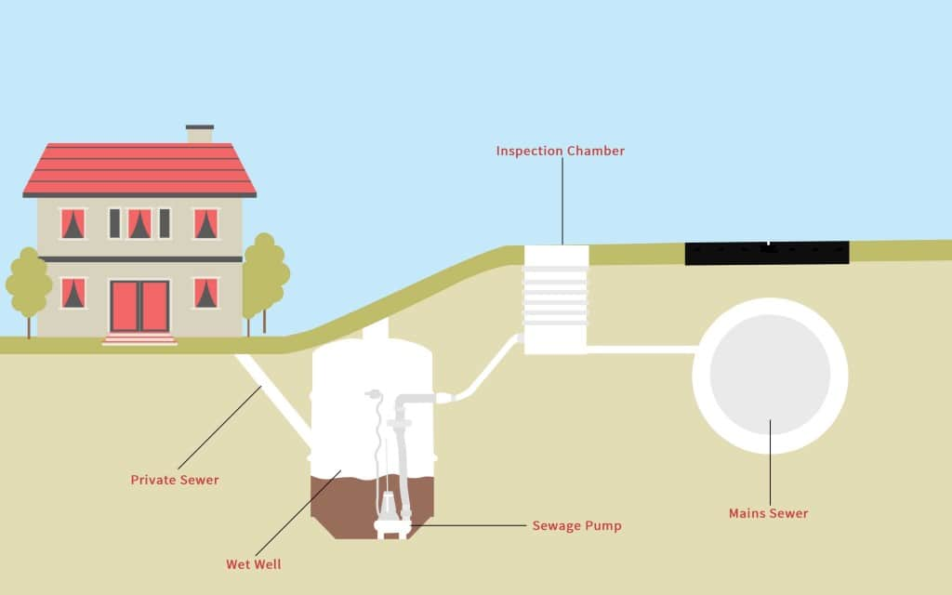
Pumping Station

Slide 33
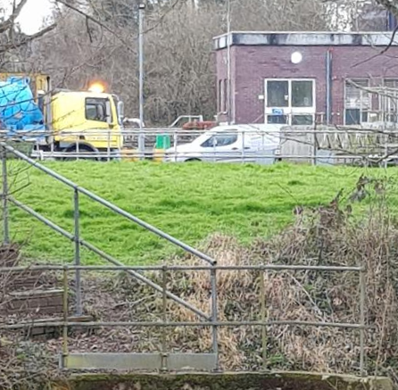
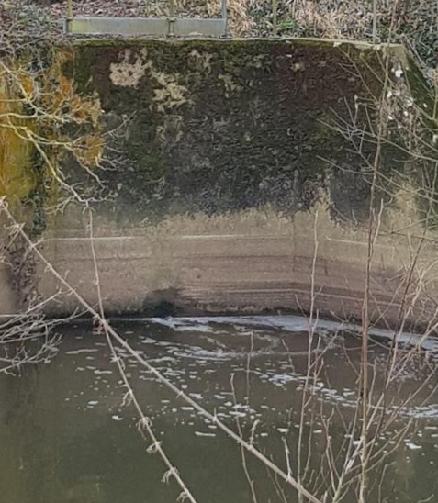
A sewage discharge?
Pixham Lane Works
Outfall 6th February 2022

Slide 34
A sewage discharge
A sewage discharge is where a release of sewage is made to either:
the ground
or
surface water (for example a river, stream,
estuary, lake, canal or coastal water)
Untreated sewage was discharged into the River Mole on 223 days over the last four years.

Slide 35
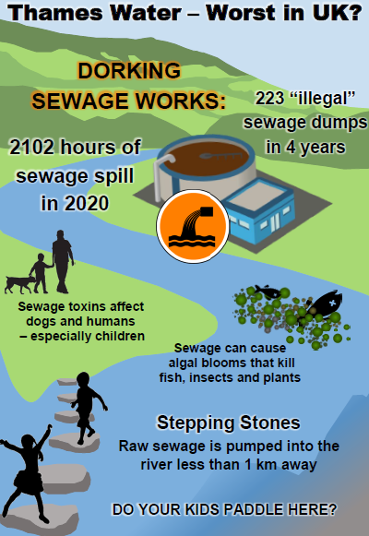

Slide 36
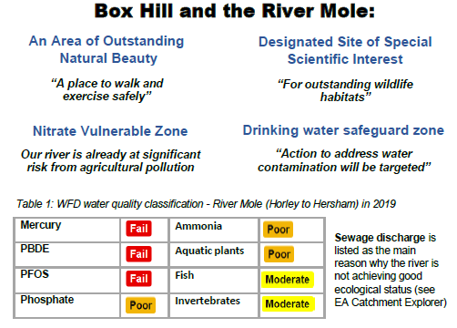

Slide 37
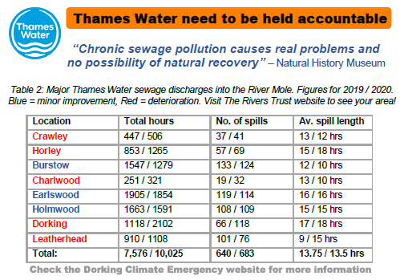

Slide 38
Investigations into sewage treatment works.
On 18 November 2021, the Environment Agency and Ofwat announced major investigations into potential widespread non-compliance by water and sewerage companies at sewage treatment works.
More than 2200 sewage treatment works spanning all water and sewerage companies in England will be scrutinised by EA experts.

Slide 39
How the EA is resourcing this work
The EA is drawing on expertise and resource from around its business to carry out this major investigation.
This will include the National Enforcement Service, water quality regulation staff, technical experts and communications teams. We are treating the investigation as we would do a major incident such as a flood, where we prioritise and brigade the resources we need.

Slide 40
Sewage Treatment.
Pixham Lane Works

