Slide 1
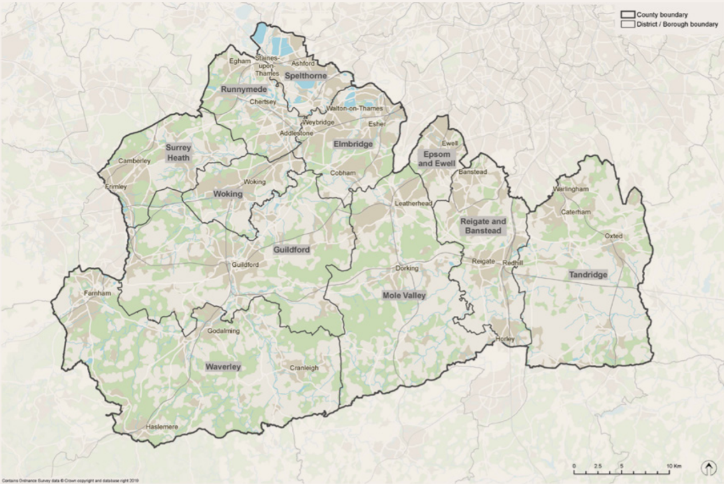
Travel and Transport in Surrey

Slide 2
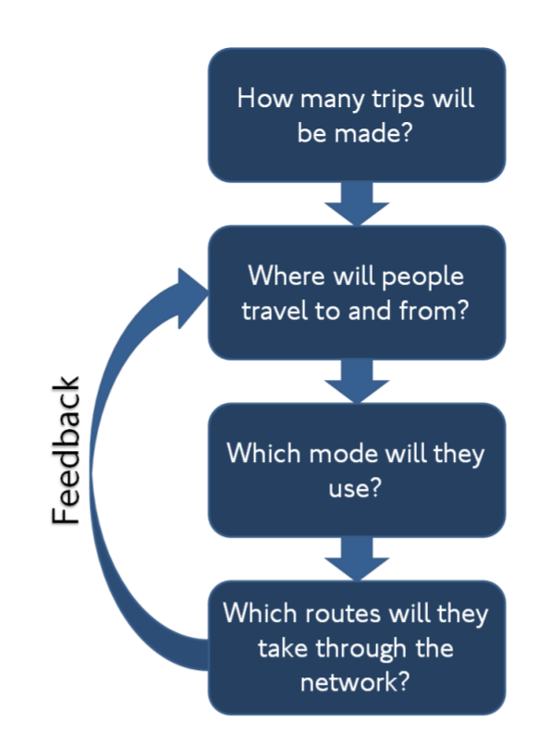
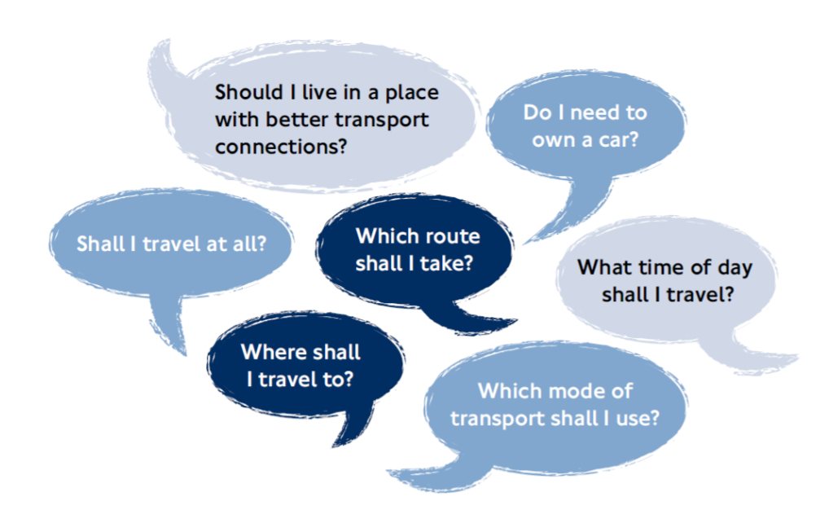
Transport Principles

Slide 3
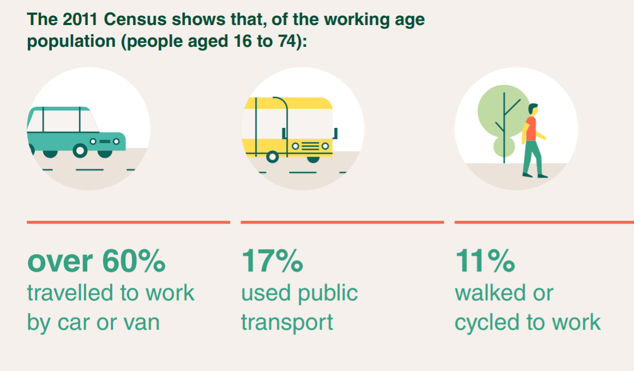
Travel in Surrey

Slide 4
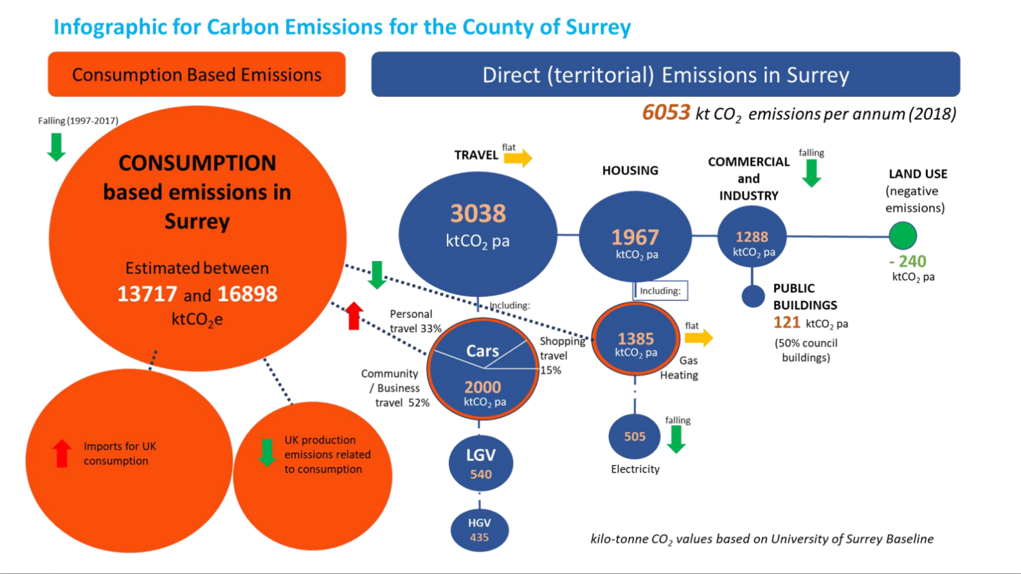

Slide 5
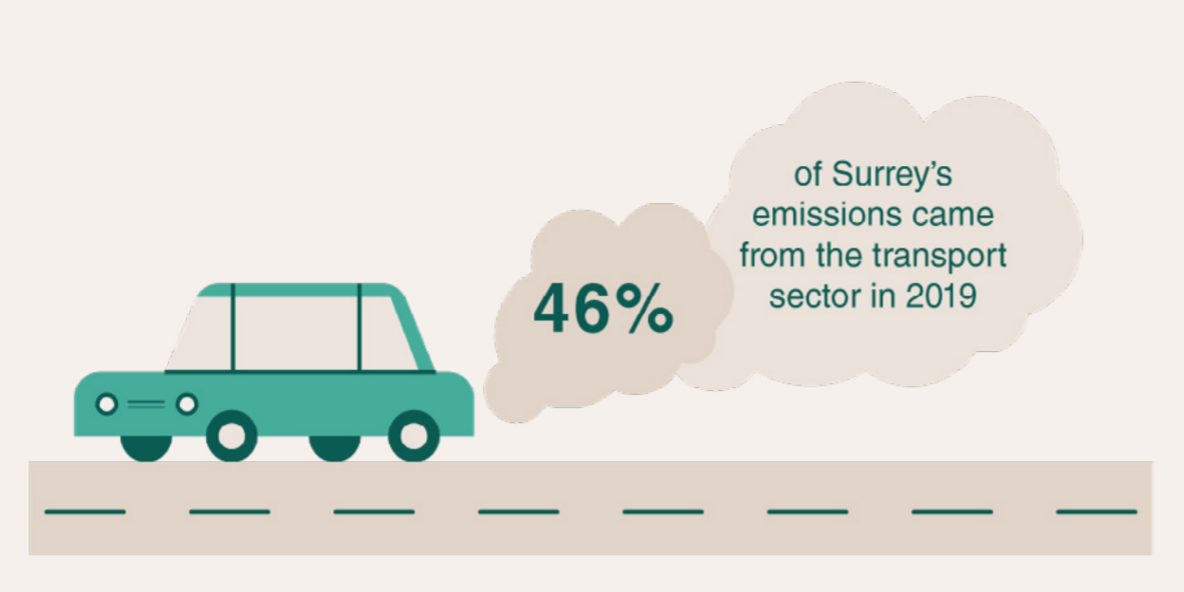

Slide 6
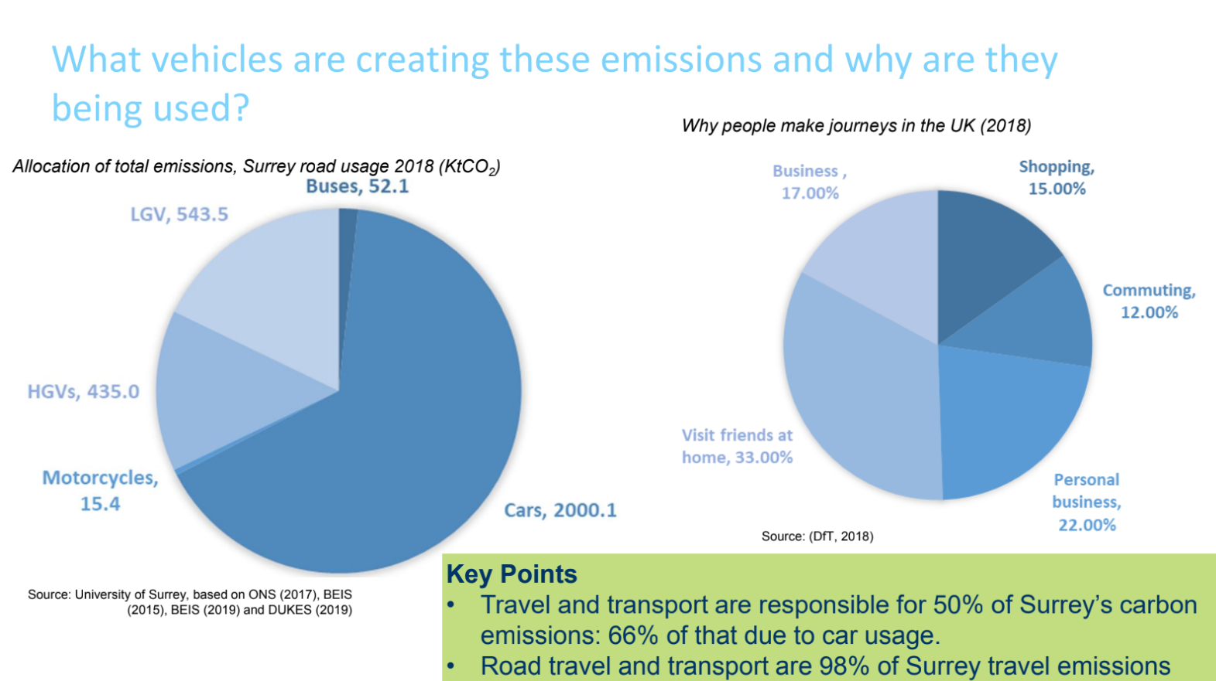

Slide 7
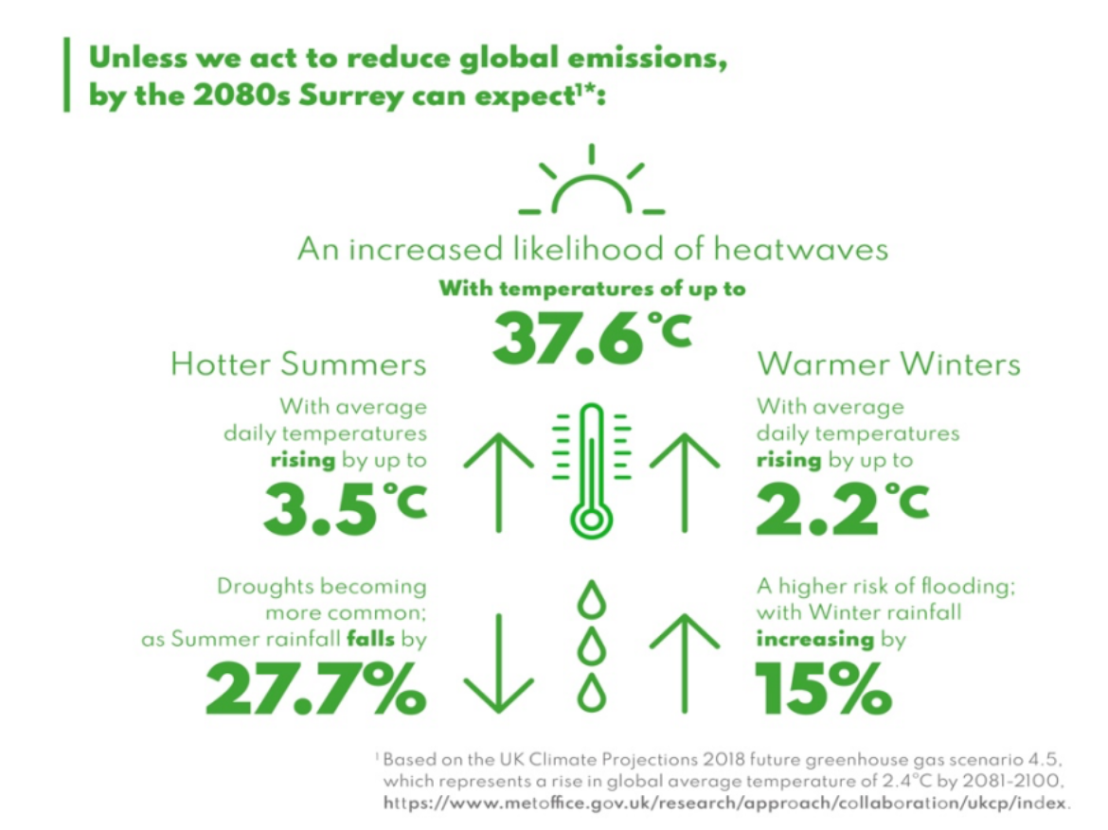

Slide 8
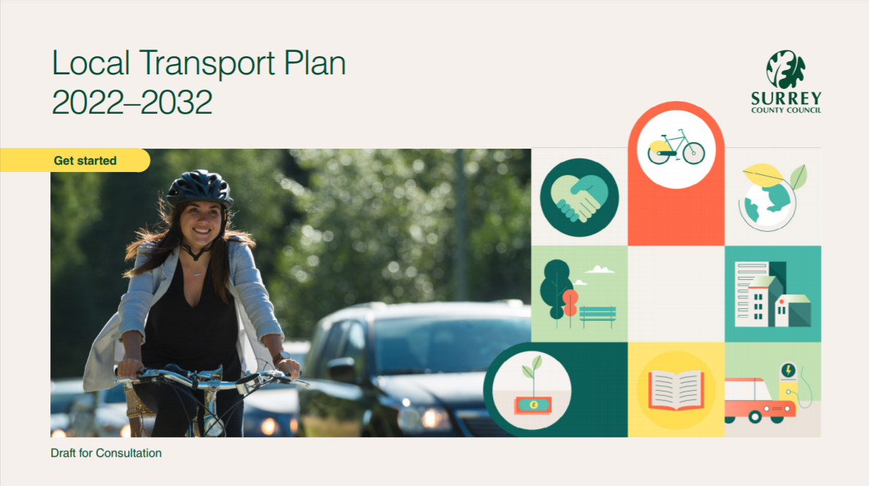
Local Travel Plan (LTP4)
Consultation until 24 October

Slide 9
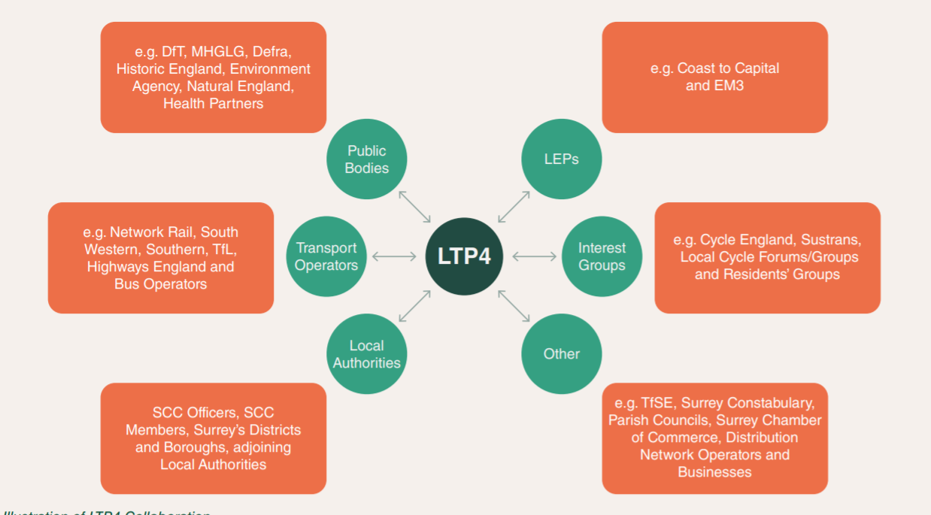

Slide 10
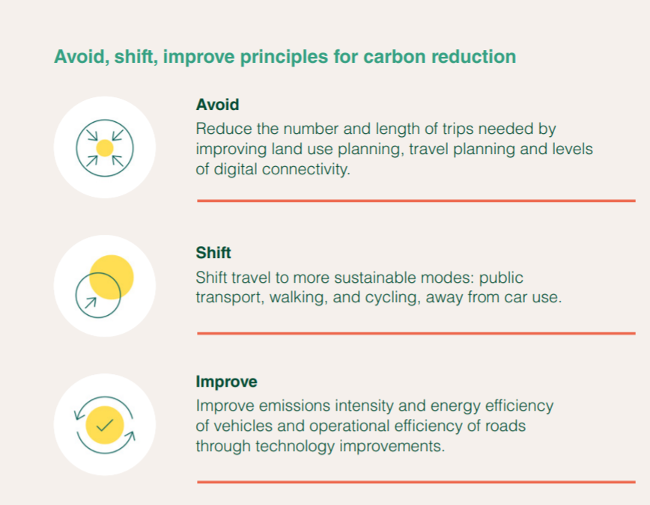

Slide 11
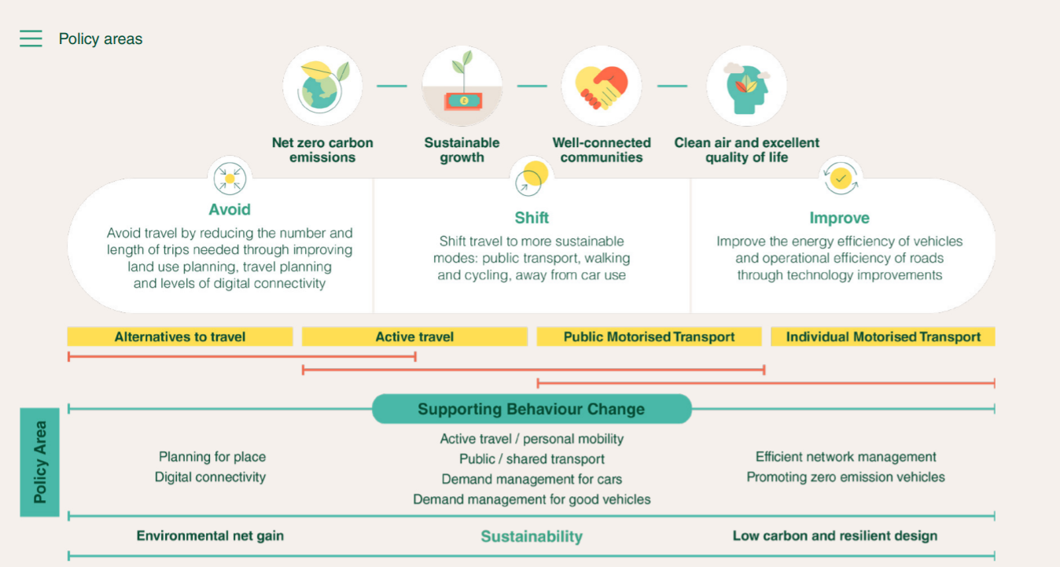

Slide 12
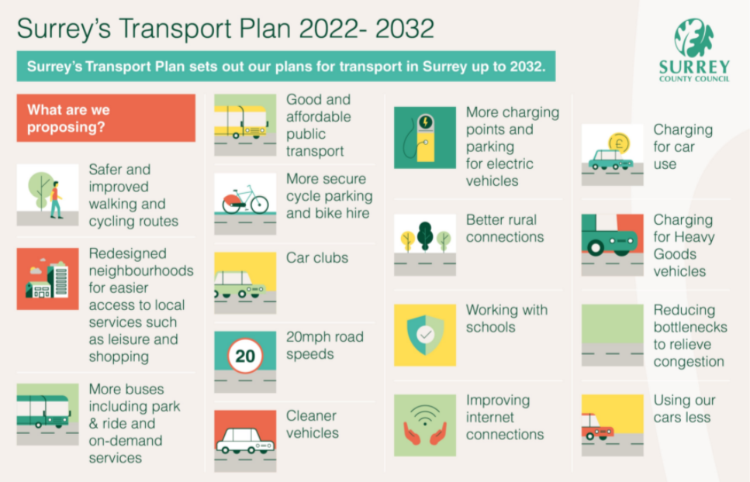

Slide 13
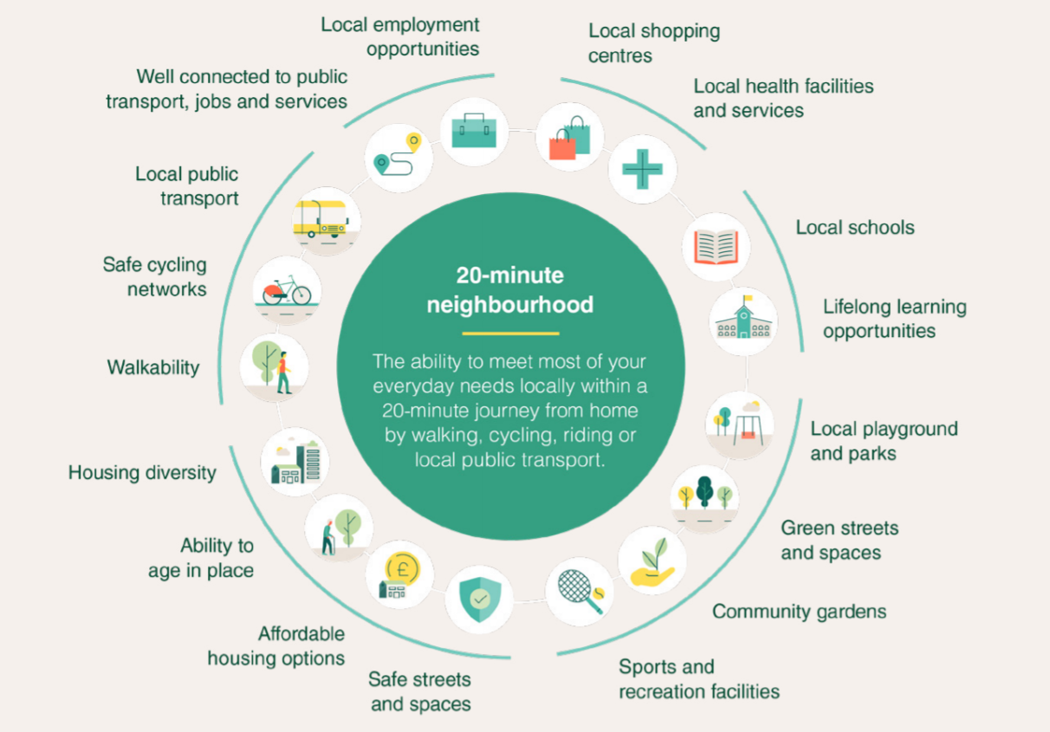
Avoid Travel

Slide 14
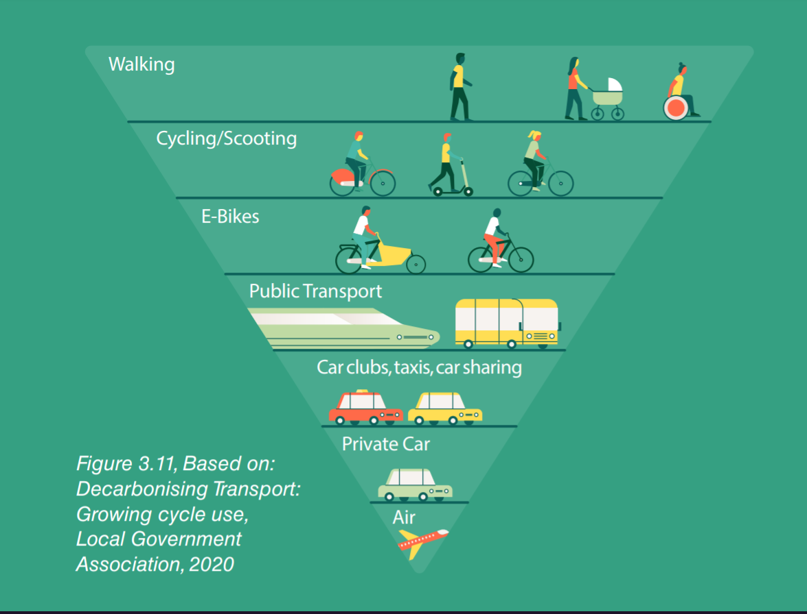
Shift to sustainable travel

Slide 15
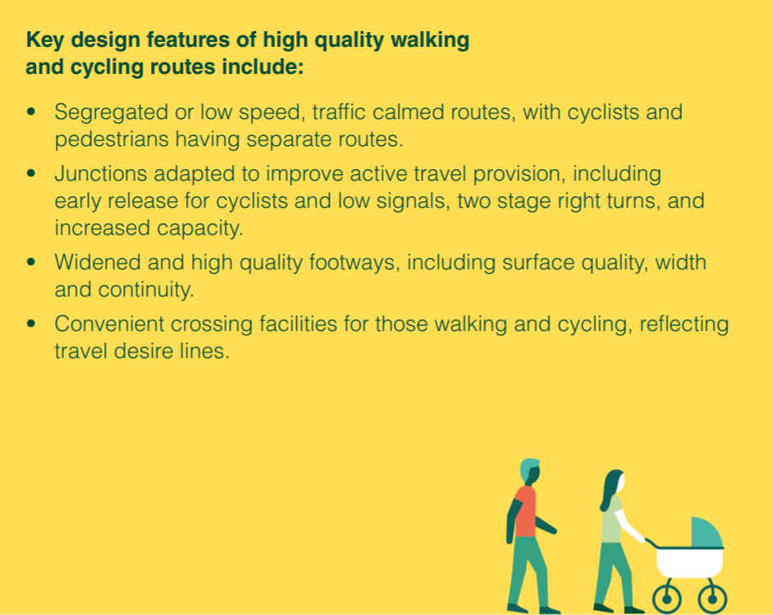
Shift > Active Travel

Slide 16

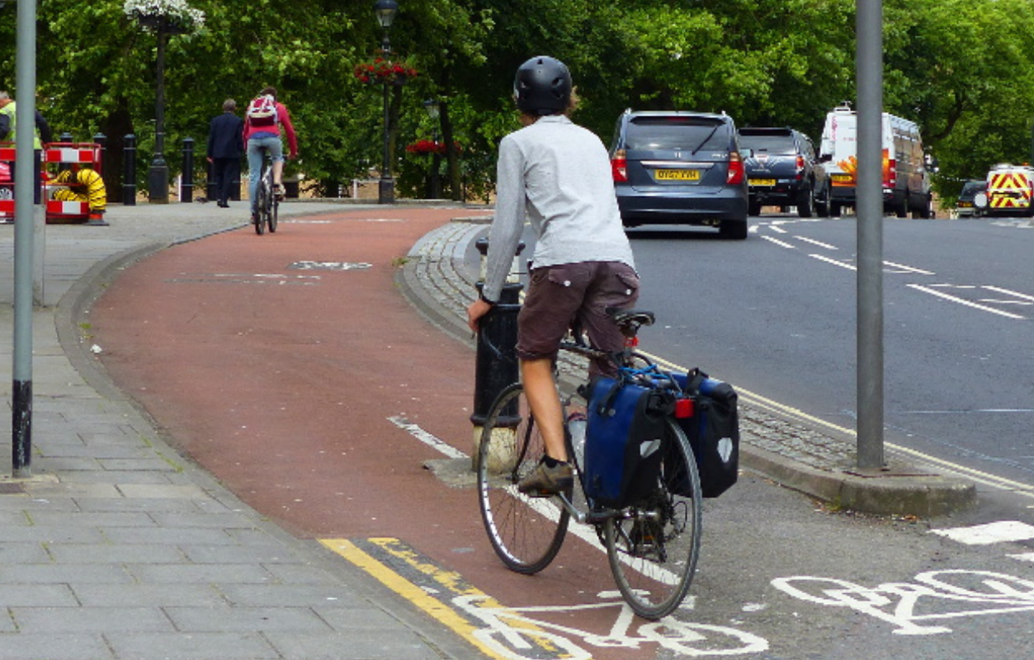
Shift > Cycling

Slide 17
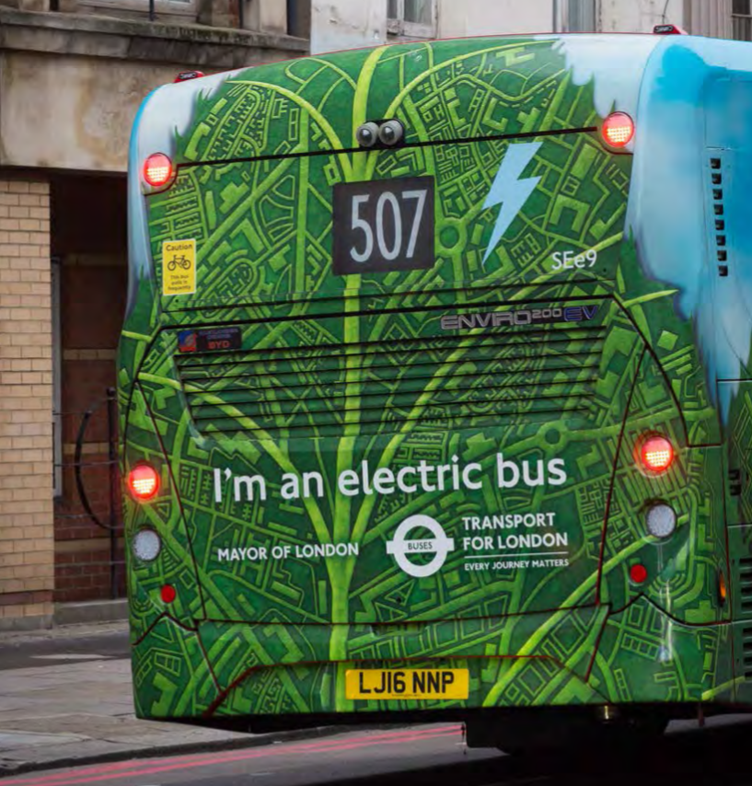
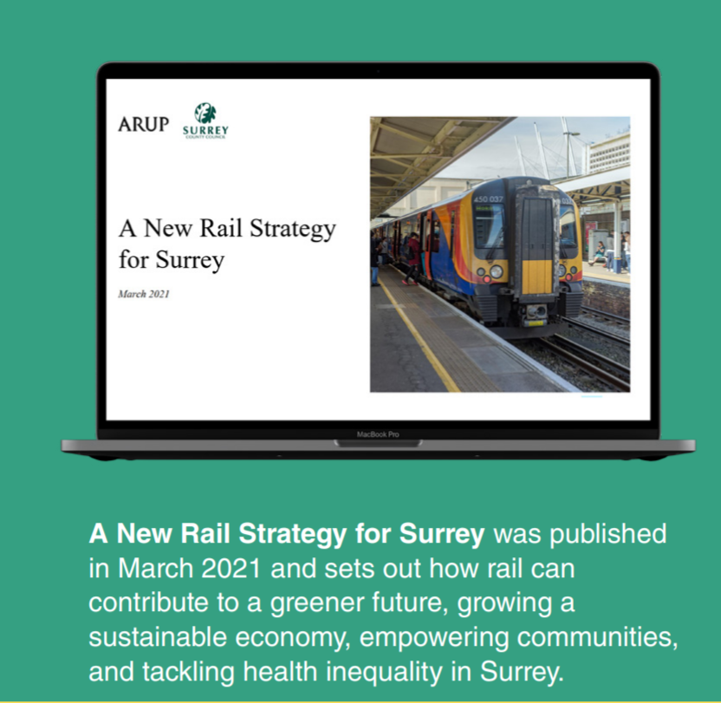
Shift > Public Transport

Slide 18
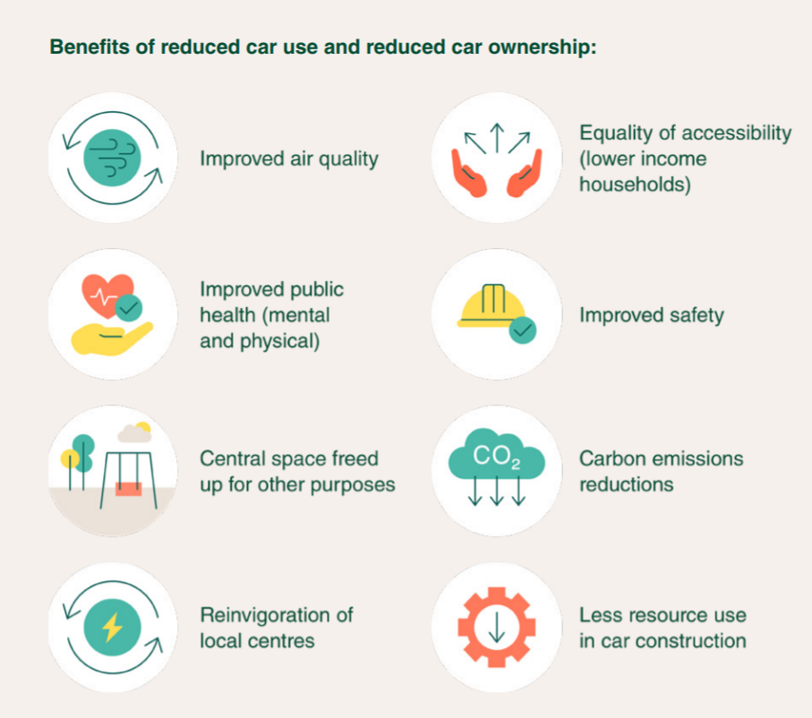
Reducing car use

Slide 19
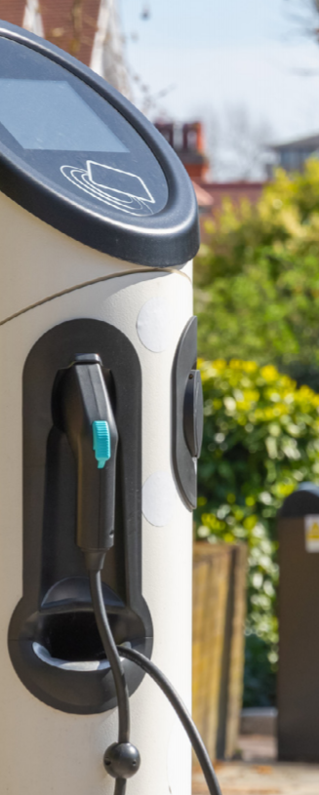

Improve

Slide 20
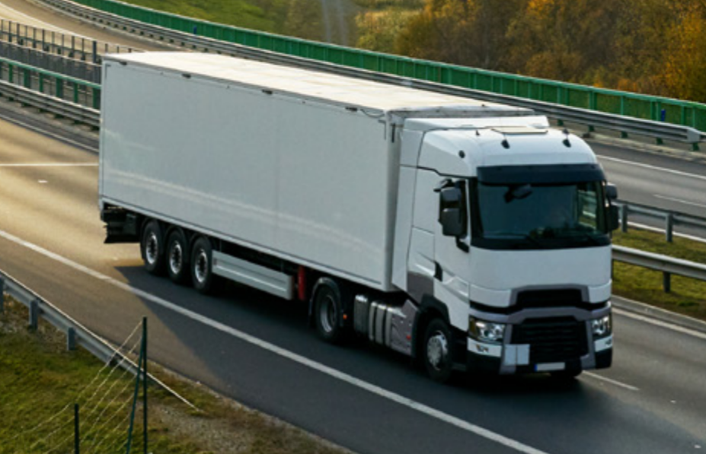
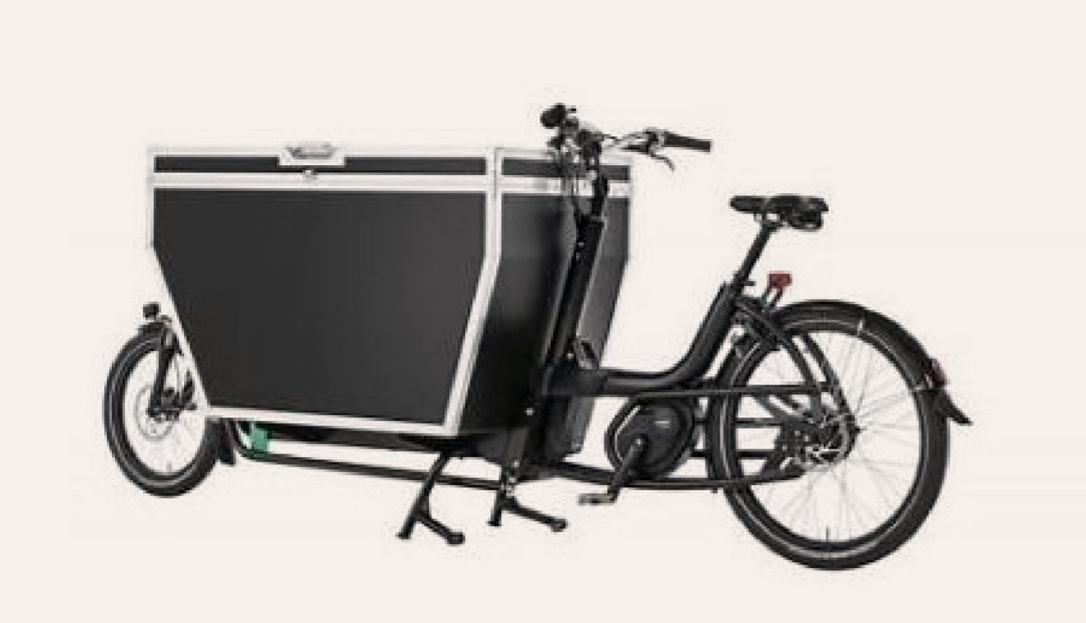
Goods deliveries

Slide 21
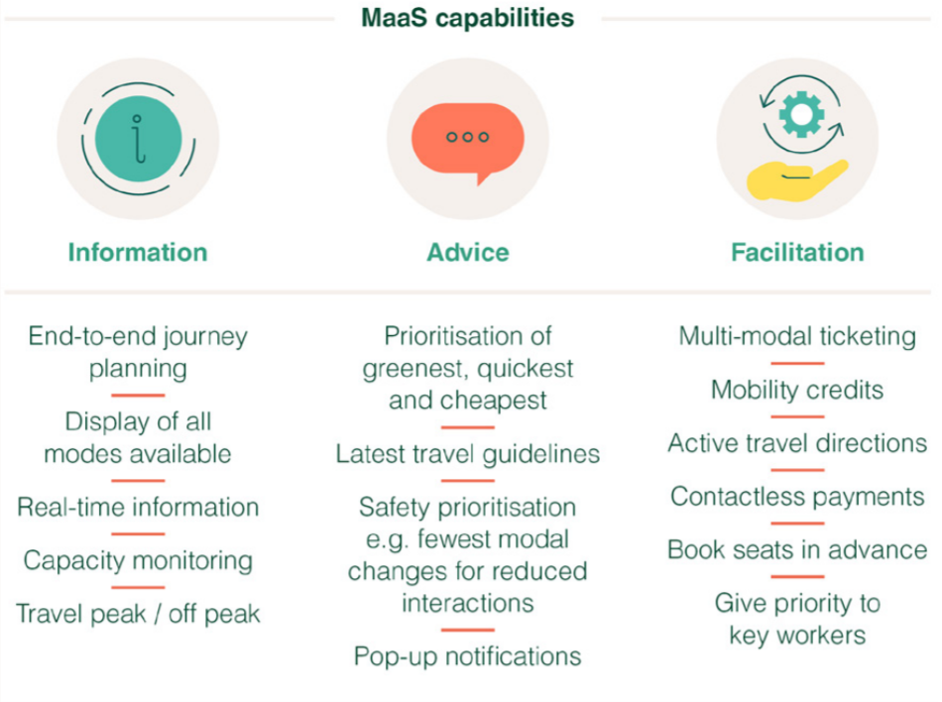
Mobility as a Service

Slide 22
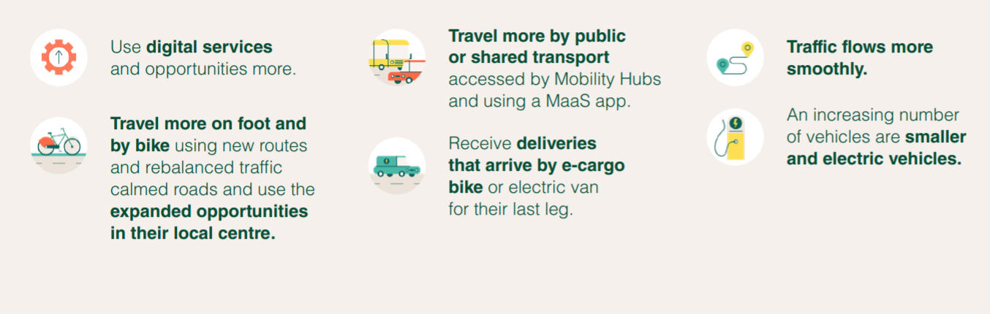
Impacts of LTP4

Slide 23


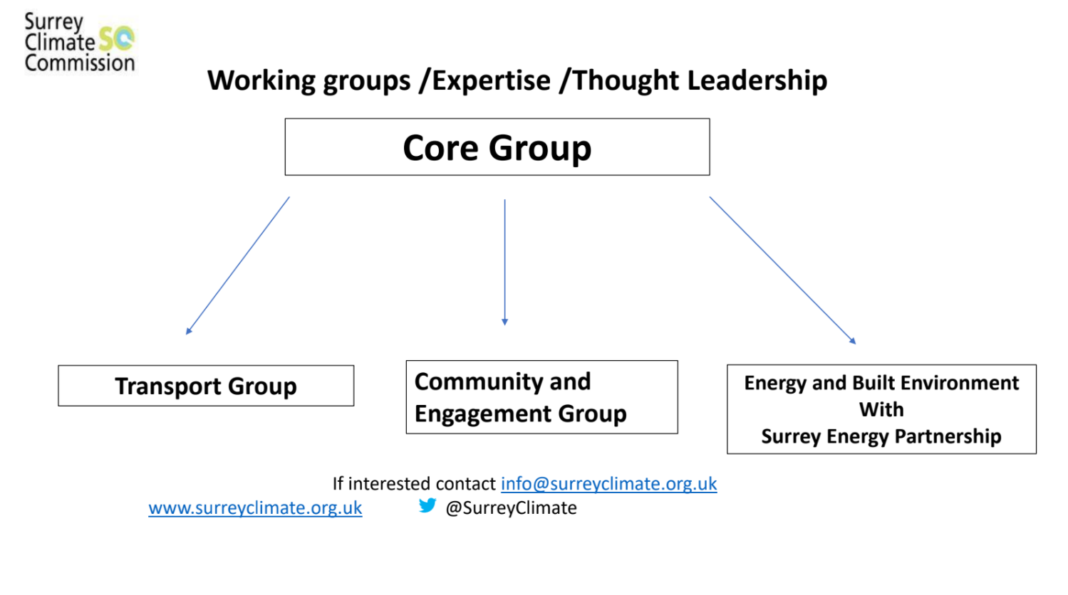


Slide 24


Slide 25
10 Points on Travel and Transport in Surrey
A. Good approach but stronger ambition needed.
1. Good overall framework.
2. Economy-wide shift implied and supported.
3. Stronger climate ambition for transport needed.

Slide 26
B. Clear vision for zero carbon transport
4. Local zero carbon plans.
5. Set out the scale of outputs required from the policies.
6. Best practice review.

Slide 27
C. Making sure it happens
7. Citizens’ Assembly on Transport in Surrey.
8. Two competing visions for UK transport - needs a change of government policy.
9. Links to National, Surrey and Borough/District local planning.
10. From policy to action.

